Slide 1

War of Brawns
Get Addicted to Fitness
Old Dominion University
CS 410 - Team Bronze
V2 Formal Feasibility Presentation
October 17, 2019
Notes:
Added date 10/17/2019

Slide 2
Table of Contents
Team Bronze………………………………………………………………………………..………………………………………………………….……………..3
Problem Background…………………………………………………………...…………………………………………………………….……………....4-6
Problem Statement………………………………………………………….…………………………………………………………………….……………...7
Problem Characteristics….…………………………………………………………..………………………………………………………….……………..8
Current Process Flow………………………………………………………..……….…………………………………………………….……………..…….9
Solution Statement……………………………………………………………...………………………………………………………….……………..…....10
Solution Characteristics………………..…………………………….……………………………………………………………………….……………...11
Solution Process Flow……………………………………………………………………………………………………………………….……………..….12
Major Functional Component Diagram (MFCD)………..………..…………………………………………………………….……………..….13
Stakeholders/End Users..…………………………………………………..………………………………………………………………………………...14
What our Solution will NOT do………………………………………….…………………………….………………………………….….……………15
Risk Matrix and Mitigation Strategies………………………………………...……………………………………………………….……………...16
Competition matrix……………………………………….…………………………………………………………………………………….……………...17
Benefits to Customer Base…………………..……………………………………………………………………………………………………………...18
Conclusion…………………………………..……………………………………………………………………………………………………….……………...19
Questions…………………………………………..………………………………………………………………………………………………….…………….20
References……………………………………………..………………………………………...…………………………………………….……………...21-22
CS 410 - Team Bronze | Fall 2019 | Old Dominion University | Page 2

Slide 3



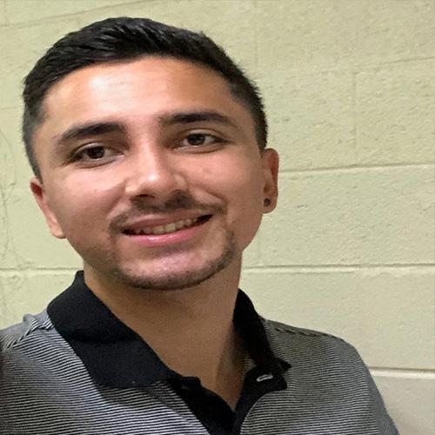



Meet the Team!
Kevin Fang
Team Lead
April McIntire
UI/UX Designer
Rodolfo Monterroso
Webmaster
Roshan Ghimire
Developer
Josten Asercion
Game Designer
Tim Novak
Back-End Developer
Shane Shifflett
Webmaster
CS 410 - Team Bronze | Fall 2019 | Old Dominion University | Page 3
Notes:
Move bottom row into center to even out spaces.

Slide 4
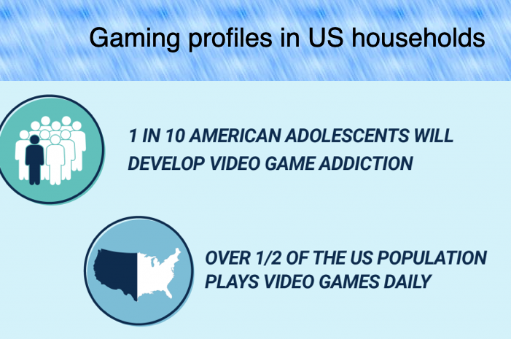
Problem Background
The World Health Organization officially claimed gaming disorder as a disease in 2018.⁸
To be diagnosed with gaming disorder, a person must show 12 months of severe symptoms, including prioritizing gaming over work, education and social relationships.⁸
64% of the U.S. Population are gamers.⁶
Globally, 75 million people suffer from gaming disorder.⁸
77% of Americans are not meeting the recommended amount of exercise by the U.S. Department of Health and Human Services ²
CS 410 - Team Bronze | Fall 2019 | Old Dominion University | Page 4
Notes:
Was trying to add in-text citation, but could not find quote for
77% of Americans are not meeting the recommended amount of exercise by the U.S. Department of Health and Human Services
Either get rid or find a quote similar that we can reference
https://health.gov/dietaryguidelines/2015/guidelines/appendix-1/

Slide 5
Negative Effects of Gaming Disorder
Social isolation ¹³
Emotional effects ¹³
Decrease in mental performance in education or other activities ¹³
Health issues
Increased risk of obesity ¹³
Headaches, backaches ⁶
Development of carpal tunnel syndrome ⁶
CS 410 - Team Bronze | Fall 2019 | Old Dominion University | Page 5
Notes:
Add references
Add more health issues other than obesity as well as issues that can occur because of obesity such as high blood pressure
Effect of sedentary lifestyle for video game addicts

Slide 6
Who is affected?
94% of males and 6% of females represent the gender breakdown for gaming disorder.⁶
Males between the ages of 18-24 are most at risk for gaming addiction.⁶
Parents, spouses, and loved ones.
CS 410 - Team Bronze | Fall 2019 | Old Dominion University | Page 6

Slide 7
Problem Statement
Gaming disorder disrupts normal life activities and causes important aspects of life to be neglected, such as maintaining a healthy dose of physical activity. Often, the combination of video gaming and a lack of physical exercise leads to health concerns such as weight gain, poor posture, and an increased risk of type 2 diabetes in America's population.¹³
CS 410 - Team Bronze | Fall 2019 | Old Dominion University | Page 7
Notes:
Changed correlation to “Often, the combination “, see about adding a citation showing correlation of video gaming, lack of exercise leads to health concerns - Kevin.

Slide 8
Problem Characteristics
Those with gaming disorder don’t find exercise as enjoyable as video games because of a lack of instant gratification.
For those with video game addiction, commitment to activities other than video games is difficult.¹³
Those with video game addiction find it unpleasant to leave their comfort area (gaming area).
Those with a video game addiction tend to practice poor dietary habits.
CS 410 - Team Bronze | Fall 2019 | Old Dominion University | Page 8
Notes:
Add references - no references that directly addressed the characteristics. If there were indirect relations then it would be added.

Slide 9
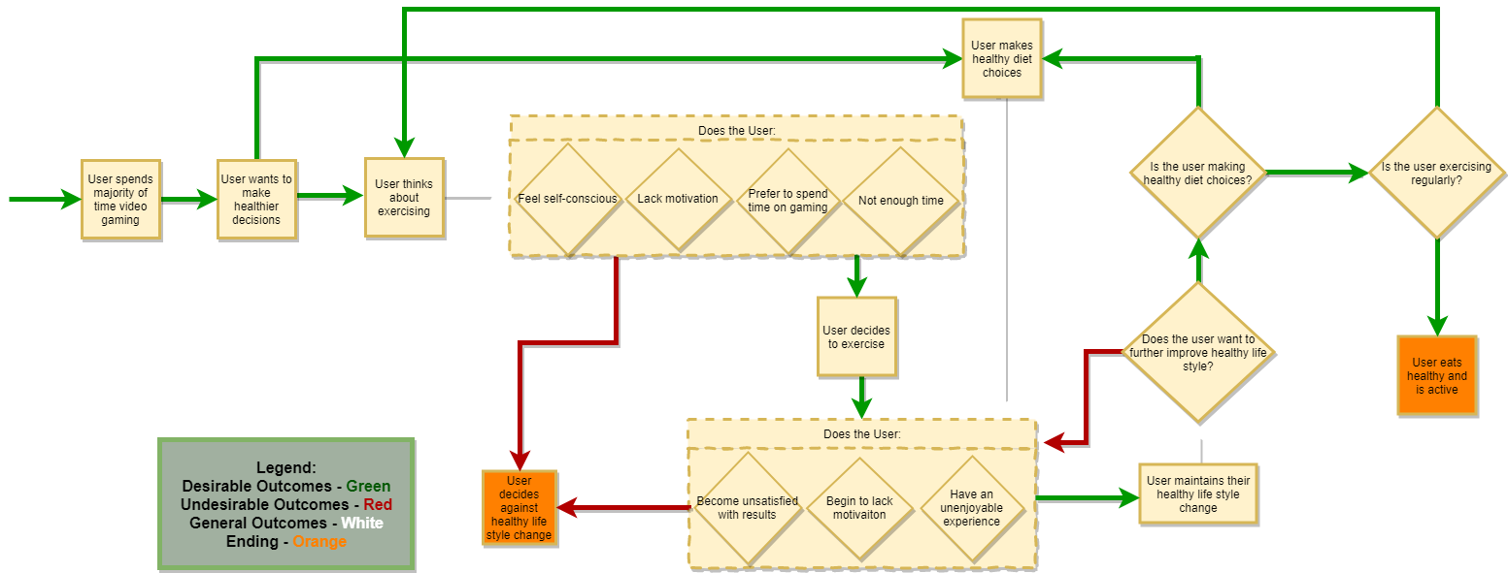
Current Process Flow
CS 410 - Team Bronze | Fall 2019 | Old Dominion University | Page 9
Notes:
Add a start and end.
Ensure that clear outcomes occur instead of an infinite loop
change process flow to show an end outcome and how the user gets to the end without the app
Tie in benefits of outcomes - at the end - The User eats healthy and is active.
Today

Slide 10
Solution Statement
War of Brawns is a mobile application that focuses on engaging video gamers in a fantasy Role-Playing Game (RPG)⁵ where the storyline and character progression relies solely on the user’s physical activity. This will help users to incorporate healthy diet and exercise habits into their lifestyle that is being neglected due to video game addiction.
CS 410 - Team Bronze | Fall 2019 | Old Dominion University | Page 10
Notes:
More detail about why the fantasy theme was chosen and is it popular?
Found this quote “The most addictive video games include massively multiplayer online games (MMOs) and role-playing games (RPGs).” in reference 5. Could be useful for argument why RPG theme was chosen.

Slide 11
Solution Characteristics
Sidetracks the long term gratification by offering instant gratification through in-game rewards and character progression.
Enforces commitment through the exploitation of video game addiction. ¹
Trackers use biometrics to ensure physical activity.
Offers a variety of challenges such as gym or home workouts that can be shown based on users preference.
Has the ability to track daily calorie intake through a diet journal.
Application will record progress towards goal weight through a line graph.
Application will include a workout guide for the user to understand proper form.
Offers interactive gameplay
CS 410 - Team Bronze | Fall 2019 | Old Dominion University | Page 11
Notes:
Changed “short term” to “instant” because of direct relation to rewards and progression.
Go back over the solution characteristics and what the solution will not do and compare and contrast, so that all components of the app will be covered and discuss where to put missing details.
Instant Gratifcation:
leaderboard, daily streaks, and medals for accomplishment in solution characteristics.
in-game rewards and progression
combat system requires progression from user
swords, armor, etc
Stat increases
If we present again, then explain more of what the instant gratification is to the user and the designer.
If we present again, then explain that even though other applications have this feature, but we want these features to be in one whole application
Game will include “workout tutorials” in the workout challenges menu which will show general form
Put in Solution Characteristics or solution flow(?)Input information about this exercise guide into the solution characteristics and competition matrix

Slide 12
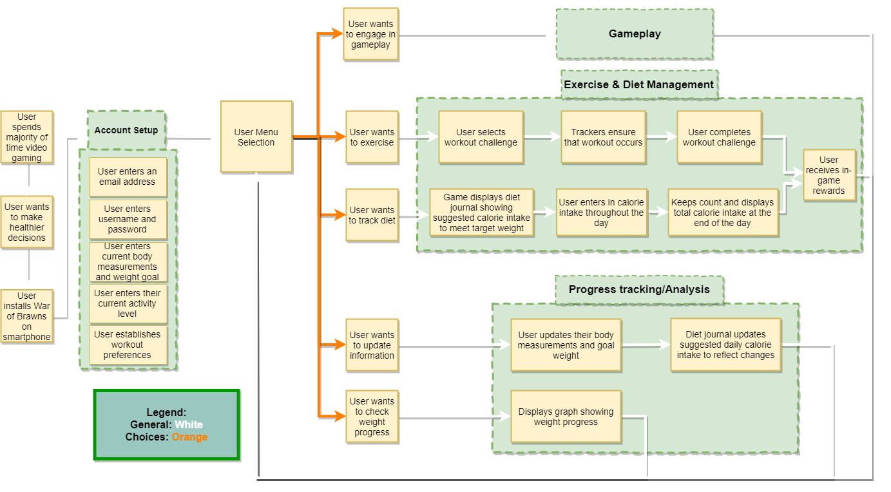
Solution Process Flow
CS 410 - Team Bronze | Fall 2019 | Old Dominion University | Page 12
Notes:
Chris - progression? instant gratification? Describing myfitness apps
Need to add gameplay aspect to flow.
May add a second solution flow for that aspect
Add colored arrows to solution process flow
Maybe things like “set up”, “in-game”
Similar to problem process flow
Add yes or no arrows to outcomes
Mention account profile
Add another box that under account setup that says the user will be able to filter the type of workout challenges they are suggested.
Implement the legend from problem process flow onto the solution
MFCD interaction with players may need adjustments.
Think about things that could be tools such as packages, etc.
Today

Slide 13
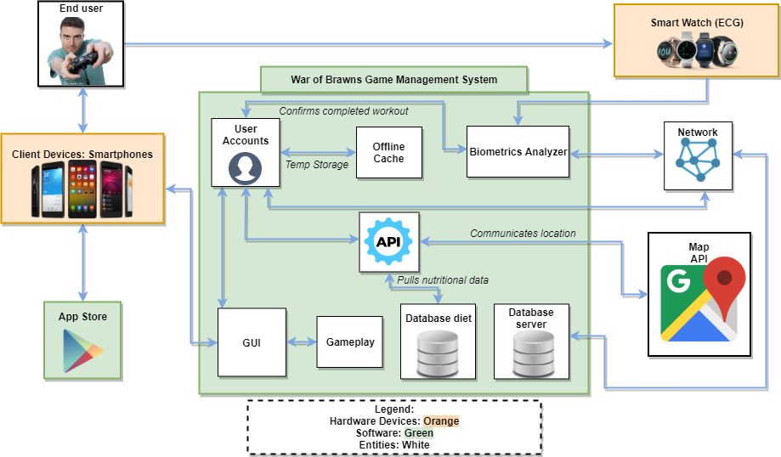
Major Functional Component Diagram
CS 410 - Team Bronze | Fall 2019 | Old Dominion University | Page 13
Notes:
Chris - high cost to start
Introduce enhancement of motion camera similar to kinect but with the smartphone camera
MFCD interaction with players may need adjustments.
Think about things that could be tools such as packages, etc.
Today

Slide 14
Customers, Users, and Stakeholders
Users/Customers
Game Addicts
Gamers (not necessarily addicts)
Exercise Enthusiasts
Stakeholders
Family and friends of game addicts
Gyms
Gold’s Gym, Planet Fitness, etc.
Personal Trainers
CS 410 - Team Bronze | Fall 2019 | Old Dominion University | Page 14
Notes:
Add stakeholders or fitness gyms - discuss

Slide 15
What our Solution will NOT do
Will not cure game addiction or take the place of gaming disorder therapy
Make users eat healthier or recommending proper dietary practices
Replace routine exercise as best method for maintaining healthy lifestyle
Be effective for gamers who “spoof” the exercise challenges
Verify that the user set a rational goal weight
Provide proper medical advice
CS 410 - Team Bronze | Fall 2019 | Old Dominion University | Page 15

Slide 16
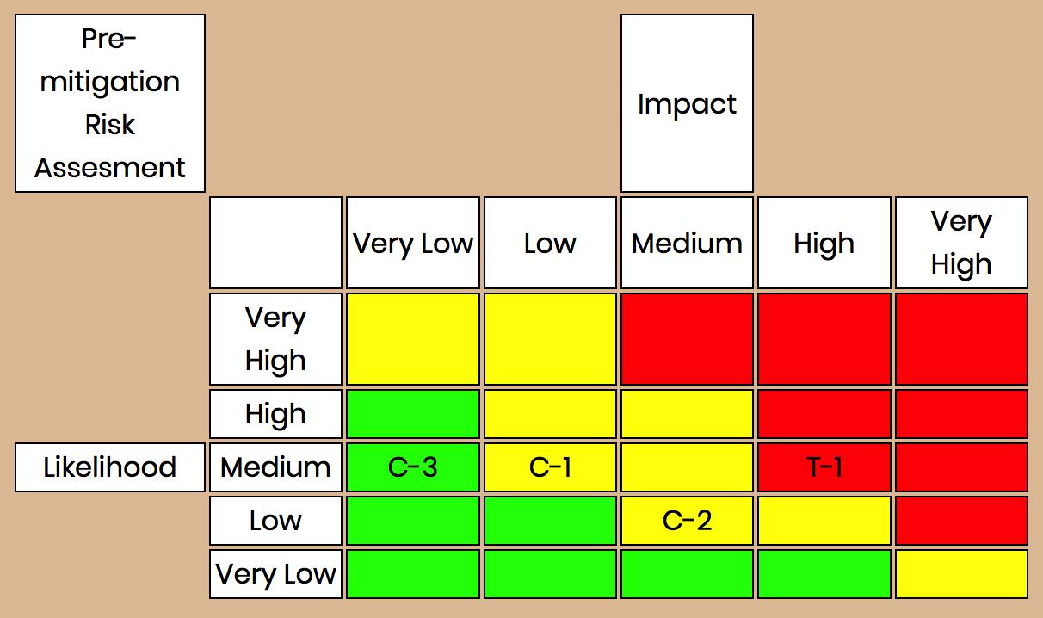
Risk Matrix and Mitigation Strategies
Technical Risks:
T-1: The server is unable to handle the API usage as the user base grows,performance degrades
Customer Risk:
C-1: User falsified information which leads to unwanted results
C-2: Customer becomes disinterested in the app?
C-3: Customer’s established impossible goals
Mitigation Strategies:
T-1: Implement a scalable architecture for our app to handle user growth.
C-1: Trackers for exercise and If algorithm detects false information then the user progression will be pushed back.
C-2: Add surveys asking for feedback and recommendations from user base to continuously improve aspects of the game and apply concept of gaming addiction to keep users interested.
C-3: App will test the established goals against a parameters to test if achievable.
CS 410 - Team Bronze | Fall 2019 | Old Dominion University | Page 16
Notes:
Got rid of “T-2: App suggests incorrect caloric intake to meet goal weight”.
Got rid of “ T-2: Verify caloric intake suggestions and perform tests on the software to ensure it has the right value. Also provide a disclaimer stating that advice given in the app does not constitute proper medical advice.”
Note: also need to change the risk matrix picture for loss of T-2.
Added “and apply concept of gaming addiction to keep users interested.” to C-2 Mitigation. To use the concept of gaming addiction to keep users entertained.

Slide 17
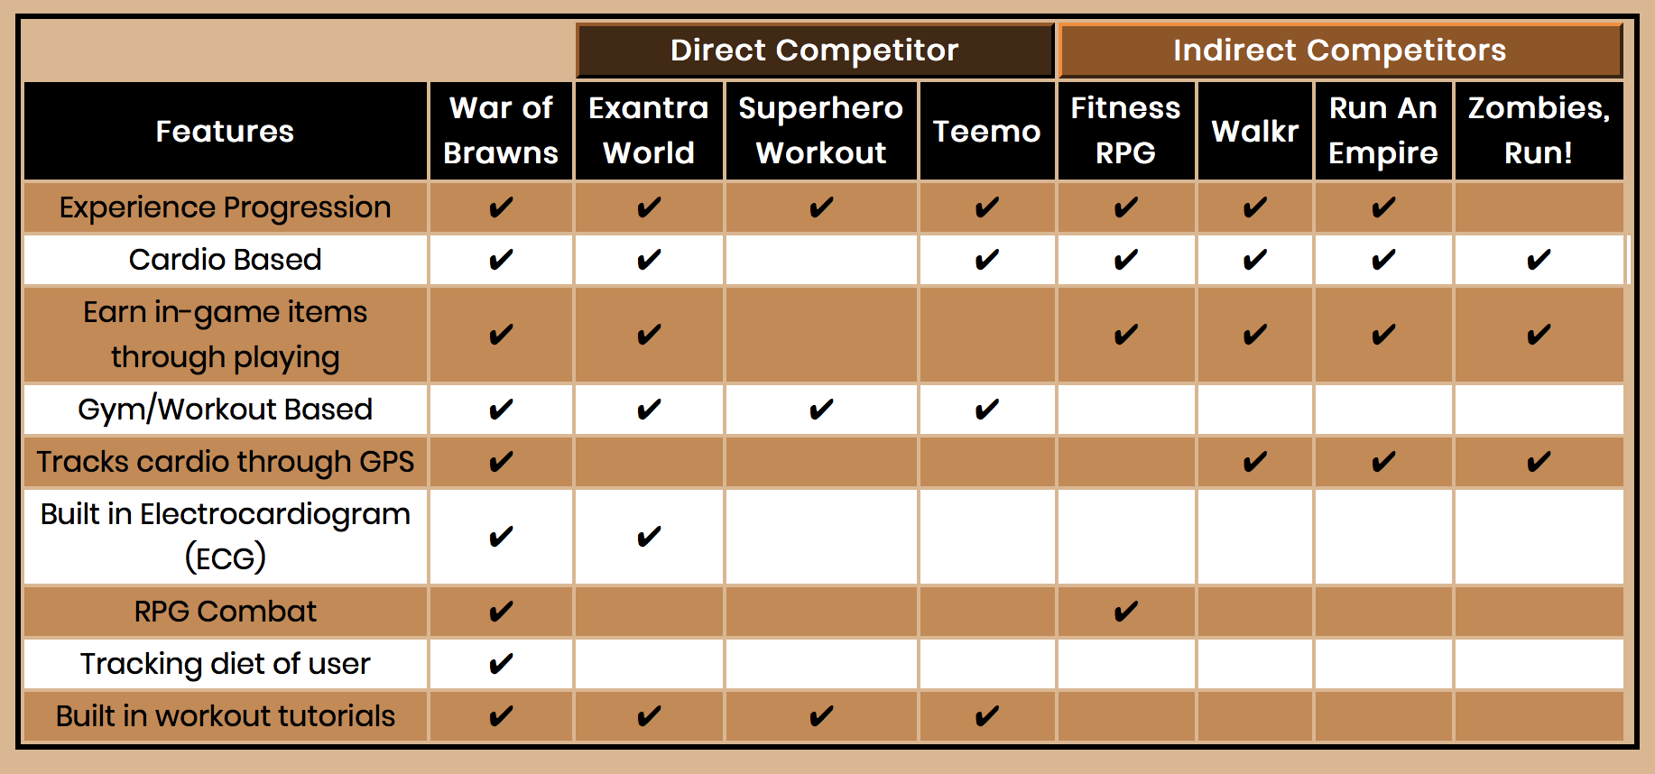
Competition Matrix
CS 410 - Team Bronze | Fall 2019 | Old Dominion University | Page 17
Notes:
Janet - built is spelled wrong in ECG row - need to change
Adds tutorial for feature

Slide 18
Benefits to Customer Base
Adds a fun aspect to exercising
Provides motivation to exercise
Tracks diet intake
Establishes a plan towards goal
Establishes an alternative lifestyle around the users game addiction
CS 410 - Team Bronze | Fall 2019 | Old Dominion University | Page 18
Notes:
Janet - address addiction in this slide
Added Establishes an alternative lifestyle around the users game addiction.

Slide 19
Conclusion
Gaming addiction is a real issue
Currently no solution to gaming addiction
Goal is to use gaming addiction as a pathway to healthy living
Gaming addicts are the primary target users
CS 410 - Team Bronze | Fall 2019 | Old Dominion University | Page 19
Notes:
In closing, gaming addiction is a real issue that has yet to see an innovative solution. Our goal is to use War of Brawns to create a pathway through gaming addiction to a healthy lifestyle. We want you to get addicted to fitness.
Some of the reference links don’t work.

Slide 20
Questions?
CS 410 - Team Bronze | Fall 2019 | Old Dominion University | Page 20

Slide 21
References
Conrad, B. (n.d.). 15 Reasons & Theories on Why Video Games Are Addictive. Retrieved October 8, 2019, from http://www.techaddiction.ca/why_are_video_games_addictive.html.
DNPAO Data, Trends and Maps: Explore by Topic. (n.d.). Retrieved October 30, 2019, from https://nccd.cdc.gov/dnpao_dtm/rdPage.aspx?rdReport=DNPAO_DTM.ExploreByTopic&islClass=PA&islTopic=PA1&go=GO.
Ellis, M. (2018, October 2). Gamified Fitness Apps That Make Working Out Fun. Retrieved October 8, 2019, from https://stylefox.co/gamified-fitness-apps-that-make-working-out-fun/.
Exantra World: Fitness RPG (Role Playing Game). (2019, September 29). Retrieved October 8, 2019, from https://www.kickstarter.com/projects/altertitan/exantra-world-fitness-rpg-role-playing-game.
Find your best self with our favorite health and fitness apps for Android. (2018, December 21). Retrieved October 8, 2019, from https://www.digitaltrends.com/mobile/best-fitness-apps-for-android/.
Gaming Addiction Statistics. (2019, September 26). Retrieved October 8, 2019, from https://www.therecoveryvillage.com/process-addiction/video-game-addiction/gaming-addiction-statistics/#gref.
Hu, F. B. (n.d.). Sedentary lifestyle and risk of obesity and type 2 diabetes. Retrieved October 8, 2019, from https://link.springer.com/article/10.1007/s11745-003-1038-4.
Ivanova, I. (2019, May 28). World Health Organization makes "gaming disorder" a medical addiction. Retrieved October 8, 2019, from https://www.cbsnews.com/news/world-health-organization-makes-gaming-disorder-a-medical-diagnosis-of-addicition/.
CS 410 - Team Bronze | Fall 2019 | Old Dominion University | Page 21

Slide 22
References
Kravitz, L. (n.d.). Exercise Motivation: What Starts and Keeps People Exercising? Retrieved October 8, 2019, from https://www.unm.edu/~lkravitz/Article%20folder/ExerciseMot.pdf
Marrs, M. (2017, November 14). 6 Fitness Apps That Make Working Out Too Fun to Skip. Retrieved October 8, 2019, from https://www.lifehack.org/articles/lifestyle/6-fitness-apps-that-make-working-out-too-fun-skip.html.
Mastroianni, B. (2018, August 29). Turning Exercise Into a Game Can Make Fitness More Fun and Effective. Retrieved October 8, 2019, from https://www.healthline.com/health-news/turning-exercise-into-a-game-can-make-fitness-more-fun-and-effective
Teemo. (n.d.). Retrieved October 8, 2019, from https://goteemo.com/.
Video Game Addiction Treatment for Teens. (n.d.). Retrieved October 8, 2019, from https://elkrivertreatment.com/treatment/treating-teen-video-game-addiction/.
Watkins, M. (2019, June 13). Video Game Addiction Symptoms and Treatment. Retrieved October 30, 2019, from https://americanaddictioncenters.org/video-gaming-addiction
CS 410 - Team Bronze | Fall 2019 | Old Dominion University | Page 22

